Slide 1

Predicting Customer Churn Likelihood, ABC Wireless By Sree Ananth Kumar Seethamraju, Eyob Tadele, Munerah AlFayez, Zade Al-Shayeb, Vamshee Deepak

Slide 2
BUSINESS PROBLEM
Churn Issue
It is more expensive to acquire a new customer than keep our existing ones.
Our Goal
Is to build a model that can predict/identify our customers who are likely to churn.

Slide 3
IMPORTANT NUMBERS
CHURN RATE | AVG. CUSTOMER LIFETIME
25% | 4 years
50% | 2 years
17 to 20 million new subscribers come from competitors

Slide 4
APPROCH TO OUR PROBLEM
GET A FEEL FOR OUR DATA
Consists of 19 features ranging from location, account length, plans, total minutes, total calls, and total charges
CONSIDERABLE CLEANUP
Contains NAs and some negative values
DATA PREPARATION
Application of RandomForest and kNN for imputation of NAs
STEPWISE REGRESSION
Helps us identify significant attributes
BUILD MODEL
Used to generate predictions
PREDICT & EVALUATE
How good are our predictions?

Slide 5
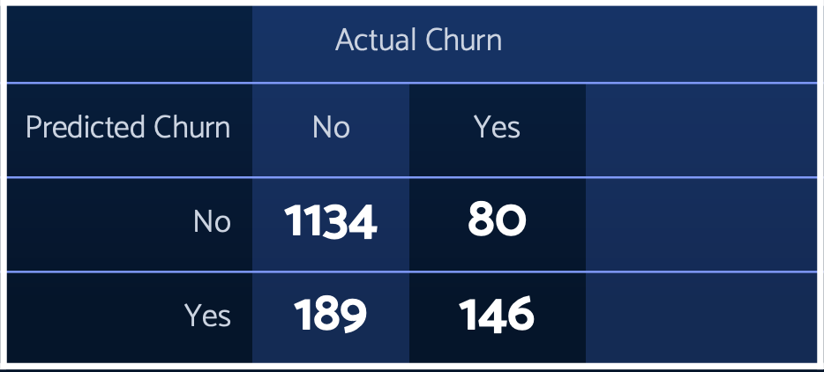
ACCURACY RATES OF OUR MODELS
We applied two models for comparison of prediction accuracy :
ModelRF-> 82%
ModelKNN-> 80%
Misclassification Rate = 1.73%
(186+81)/1547

Slide 6
INSIGHTS FROM PREDICTION
Number of Service Calls
The lower the service call, the more likelihood of churn.
Maintain regular contact!!
Total International Calls and Total International Charges
We should promote our international plans more competitively in order to reduce churn
Total Day Calls and Total Day Charges
correlation plot simply tells us that the more time spent calling (day, evening, or night), the more the charge. It is positive correlation between minutes spent in a call (day, evening, or night) and charges incurred (day, evening, or night).

